Slide 1

CSE 3521: Introduction to Artificial Intelligence
[Many slides are adapted from the UC Berkeley. CS188 Intro to AI at UC Berkeley and previous CSE 3521 course at OSU.]

Slide 2
What is Probability?
“The probability the coin will land heads is 0.5”
Q: what does this mean?

Slide 3
What is Probability?
“The probability the coin will land heads is 0.5”
Q: what does this mean?
Interpretations:
Frequentist (Repeated trials)
If we flip the coin many times…

Slide 4
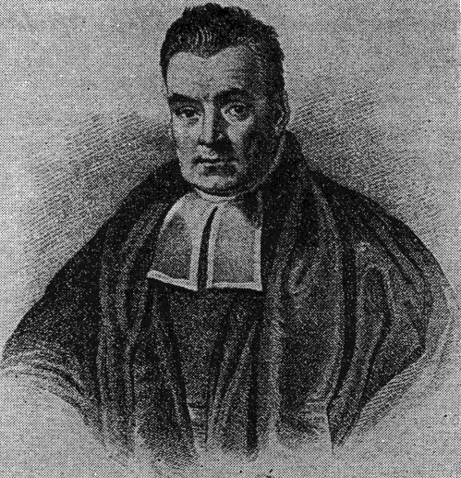
What is Probability?
“The probability the coin will land heads is 0.5”
Q: what does this mean?
Interpretations:
Frequentist (Repeated trials)
If we flip the coin many times…
Bayesian
We believe there is equal chance of heads/tails
Advantage: events that do not have long term frequencies

Slide 5
What is Probability?
“The probability the coin will land heads is 0.5”
Q: what does this mean?
Interpretations:
Frequentist (Repeated trials)
If we flip the coin many times…
Bayesian
We believe there is equal chance of heads/tails
Advantage: events that do not have long term frequencies
Q: What is the probability the polar ice caps will melt by 2050?

Slide 6
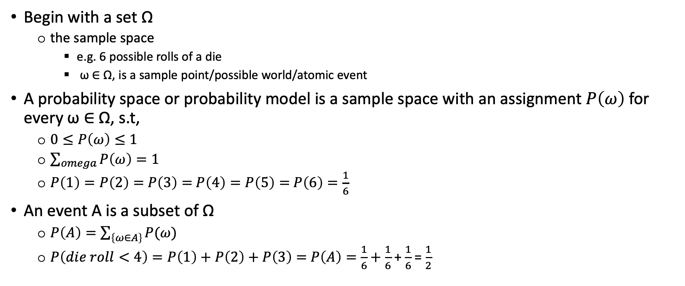
Probability Basic
Begin with a set Ω
the sample space
e.g. 6 possible rolls of a die
ω ∈ Ω, is a sample point/possible world/atomic event
A probability space or probability model is a sample space with an assignment $P\left(ω\right)$for every ω ∈ Ω, s.t,
$0≤P\left(ω\right)≤1$
$\sum_{omega}{P\left(ω\right)=1}$
$P\left(1\right)=P\left(2\right)=$ $P\left(3\right)=$ $P\left(4\right)=P\left(5\right)=$ $P\left(6\right)=\frac{1}{6}$
An event A is a subset of Ω
$P\left(A\right)=\sum_{\left\{ω∈A\right\}}{P(ω)}$
$P\left(die roll<4\right)=P\left(1\right)+$ $P\left(2\right)+$ $P\left(3\right)=$ $P\left(A\right)=\frac{1}{6}+\frac{1}{6}$ + $\frac{1}{6}$ = $\frac{1}{2}$

Slide 7
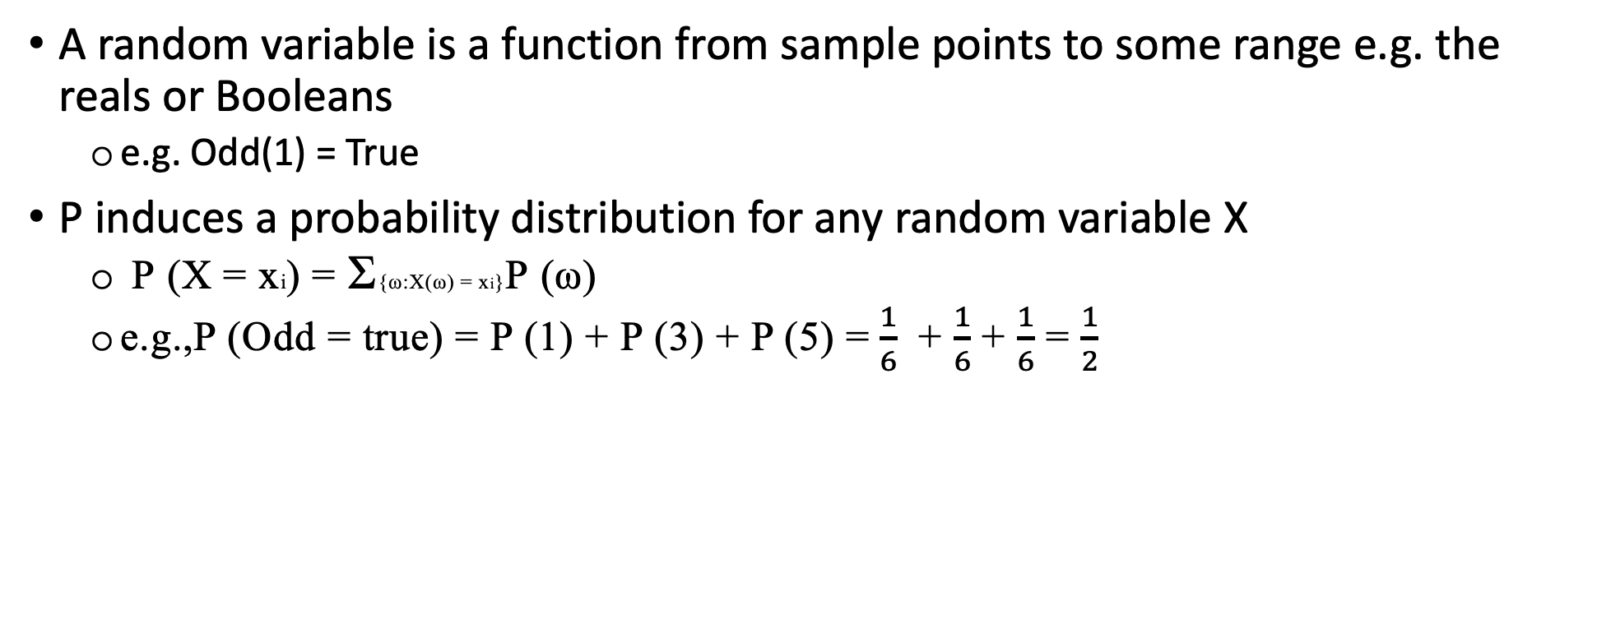
Random Variables
A random variable is a function from sample points to some range e.g. the reals or Booleans
e.g. Odd(1) = True
P induces a probability distribution for any random variable X
$\text{P} \text{(}\text{X} \text{=} \text{x}\text{i}\text{)} \text{=} \text{Σ}\text{\{}\text{ω}\text{:}\text{X}\text{(}\text{ω}\text{)} \text{=} \text{x}\text{i}\text{\}}\text{P} \text{(}\text{ω}\text{)}$
e.g.,P (Odd = true) = P (1) + P (3) + P (5) = $\frac{1}{6}$ + $\frac{1}{6}$ + $\frac{1}{6}$ = $\frac{1}{2}$

Slide 8
Proposition
Think of a proposition as the event (set of sample points) where the proposition is true
Given Boolean random variables A and B
event a = set of sample points where A(ω) = true
event ¬a = set of sample points where A(ω) = false
event a ∧ b = points where A(ω) = true and B(ω) = true
Often in AI applications, the sample points are defined by the values of a set of random variables,
i.e., the sample space is the Cartesian product of the ranges of the variables
With Boolean variables, sample point = propositional logic model
e.g., A = true, B = f alse, or a ∧ ¬b.
Proposition = disjunction of atomic events in which it is true
e.g., (a ∨ b) ≡ (¬a ∧ b) ∨ (a ∧ ¬b) ∨ (a ∧ b) ⇒ P (a ∨ b) = P (¬a ∧ b) + P (a ∧ ¬b) + P (a ∧ b)

Slide 9
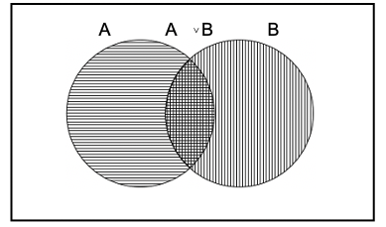
Syntax
The definitions imply that certain logically related events must have related probabilities
e.g., P (a ∨ b) = P (a) + P (b) − P (a ∧ b)
de Finetti (1931): An agent who bets according to probabilities that violate these axioms can be forced to bet so as to lose money regardless of outcome.

Slide 10
Why we should use probability
Propositional or Boolean random variables
e.g., Cavity (do I have a cavity?)
Cavity = true is a proposition, also written cavity
Discrete random variables (finite or infinite)
e.g., Weather is one of sunny, rain, cloudy, snow
Weather = rain is a proposition
Values must be exhaustive and mutually exclusive
Continuous random variables (bounded or unbounded)
e.g., Temp = 21.6; also allow, e.g., Temp < 22.0.
Arbitrary Boolean combinations of basic propositions

Slide 11
Prior probability
Prior or unconditional probabilities of propositions
e.g., P (Cavity = true) = 0.1 and P (Weather = sunny) = 0.72
correspond to belief prior to arrival of any (new) evidence
Probability distribution gives values for all possible assignments:
P(Weather) = 0.72, 0.1, 0.08, 0.1 (normalized, i.e., sums to 1)
Joint probability distribution for a set of random variables gives the probability of every atomic event on those random variables
i.e., every sample point
P(Weather, Cavity) = a 4 × 2 matrix of values
Every question about a domain can be answered by the joint distribution because every event is a sum of sample points
Weather | Sunny | Rain | Cloudy | Snow
Cavity= True | 0.144 | 0.02 | 0.016 | 0.02
Cavity = False | 0.576 | 0.08 | 0.064 | 0.08

Slide 12
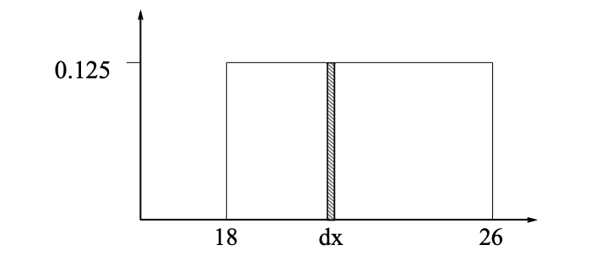
Probability for Continuous Varibales
Express distribution as a parameterized function of value:
P (X = x) = U [18, 26](x) = uniform density between 18 and 26
Here P is a density; integrates to 1.
P (X = 20.5) = 0.125 really means
_{dx}lim→0 P(20.5 ≤ X ≤ 20.5 + dx)/dx = 0.125

Slide 13
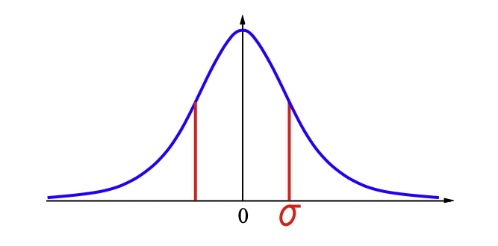

Gaussian Density
$P\left(X\right)=\frac{1}{2πσ^{2}}e^{−{{\left\{x−u\right\}}^{2}/2σ}^{2}}$

Slide 14
Conditional Probability
Conditional or posterior probabilities
e.g., P (cavity | toothache) = 0.8
i.e., given that toothache is all I know
NOT “if toothache then 80% chance of cavity”
Notation for conditional distributions:
P(cavity | toothache) = 2-element vector of 2-element vectors)
If we know more, e.g., cavity is also given, then we have
P (cavity | toothache, cavity) = 1
Note: the less specific belief remains valid after more evidence arrives
but it is not always useful
New evidence may be irrelevant, allowing simplification
e.g.,P (cavity | toothache, 49℃ Weather) = P (cavity | toothache) = 0.8
This kind of inference, sanctioned by domain knowledge, is crucial

Slide 15

Inference by Enumeration
Start with joint distribution
For any proposition, $Φ$, sum the atomic events where it is true
$P\left(Φ\right)=\sum_{ω:ω |=Φ}{P\left(ω\right)}$
 | toothache |  | ¬toothache
 | catch | ¬catch | catch | ¬catch
cavity | 0.108 | 0.012 | 0.072 | 0.008
¬cavity | 0.016 | 0.064 | 0.144 | 0.576

Slide 16

Inference by Enumeration
Start with joint distribution
For any proposition, $Φ$, sum the atomic events where it is true
$P\left(Φ\right)=\sum_{ω:ω |=Φ}{P\left(ω\right)}$
P (toothache) = 0.108 + 0.012 + 0.016 + 0.064 = 0.2
 | toothache |  | ¬toothache
 | catch | ¬catch | catch | ¬catch
cavity | 0.108 | 0.012 | 0.072 | 0.008
¬cavity | 0.016 | 0.064 | 0.144 | 0.576

Slide 17

Inference by Enumeration
Start with joint distribution
For any proposition, $Φ$, sum the atomic events where it is true
$P\left(Φ\right)=\sum_{ω:ω |=Φ}{P\left(ω\right)}$
P(cavity ∨ toothache) = 0.108 + 0.012 + 0.072 + 0.008 + 0.016 + 0.064 = 0.28
 | toothache |  | ¬toothache
 | catch | ¬catch | catch | ¬catch
cavity | 0.108 | 0.012 | 0.072 | 0.008
¬cavity | 0.016 | 0.064 | 0.144 | 0.576

Slide 18

Inference by Enumeration
Start with joint distribution
For any proposition, $Φ$, sum the atomic events where it is true
$P\left(Φ\right)=\sum_{ω:ω |=Φ}{P\left(ω\right)}$
P(no cavity | toothache) = $\frac{P( ¬ cavity\text{∧} toothache) }{P ( toothache)}$ = $\frac{0.016+0.064}{0.108+0.012 +0.016+ 0.064}$ = 0.4
 | toothache |  | ¬toothache
 | catch | ¬catch | catch | ¬catch
cavity | 0.108 | 0.012 | 0.072 | 0.008
¬cavity | 0.016 | 0.064 | 0.144 | 0.576

Slide 19
Normalization
Start with joint distribution
Denominator can be viewed as a normalization constant α
P(cavity| toothache) = α P(Cavity, toothache) = α [P(Cavity, toothache, catch) + P(Cavity, toothache, ¬catch)] = α [ < 0.108, 0.016 > + < 0.012, 0.064 > ] = α < 0.12, 0.08 > = < 0.6, 0.4 >
General idea: compute distribution on query variable
by fixing evidence variables and summing over hidden variables
 | toothache |  | ¬toothache
 | catch | ¬catch | catch | ¬catch
cavity | 0.108 | 0.012 | 0.072 | 0.008
¬cavity | 0.016 | 0.064 | 0.144 | 0.576

Slide 20
Inference by Enumeration
Let X be all the variables. Typically, we want
the posterior joint distribution of the query variables Y given specific values e for the evidence variables E
Let the hidden variables be H = X − Y − E
Then the required summation of joint entries is done by summing out the hidden variables:
P(Y|E = e) = αP(Y, E = e) = αΣ_{h}P(Y, E = e, H = h)
The terms in the summation are joint entries because Y, E, and H together exhaust the set of random variables
Obvious problems
Worst-case time complexity O(d^{n}) where d is the largest arity
Space complexity O(d^{n}) to store the joint distribution
How to find the numbers for O(d^{n}) entries???

Slide 21
Independence
A and B are independent iff
P(A|B) = P(A) or P(B|A) = P(B) or P(A, B) = P(A)P(B)
P( toothache, catch, cavity, weather) = P( toothache, catch, cavity) P(weather)
32 entries reduced to 12; for n independent biased coins, 2^{n}→ n
Absolute independence powerful but rare
Dentistry is a large field with hundreds of variables, none of which are independent.
What to do?
Cavity decomposes into Toothache Catch
Toothache Catch
Weather
Weather

Slide 22
Conditional Independence
P( toothache, cavity, catch) has 2³ − 1 = 7 independent entries
If I have a cavity, the probability that the probe catches in it doesn’t depend on whether I have a toothache:
P (catch|toothache, cavity) = P (catch|cavity)
The same independence holds if I haven’t got a cavity:
P (catch|toothache, ¬cavity) = P (catch|¬cavity)
Catch is conditionally independent of toothache given cavity:
P( catch|toothache, cavity) = P(catch|cavity)
Equivalent statements:
P( toothache| catch, cavity) = P( toothache| cavity)
P(toothache, catch| cavity) = P( toothache|cavity) P( catch|cavity)

Slide 23
Conditional Independence
Write out full joint distribution using chain rule: P(toothache, catch, cavity) = P(toothache| catch, cavity)P(catch, cavity) = P(toothache| catch, cavity)P(catch | cavity) P(cavity) = P(toothache| cavity)P(catch | cavity) P(cavity)
In most cases, the use of conditional independence reduces the size of the representation of the joint distribution from exponential in n to linear in n.
Conditional independence is our most basic and robust form of knowledge about uncertain environments.

Slide 24
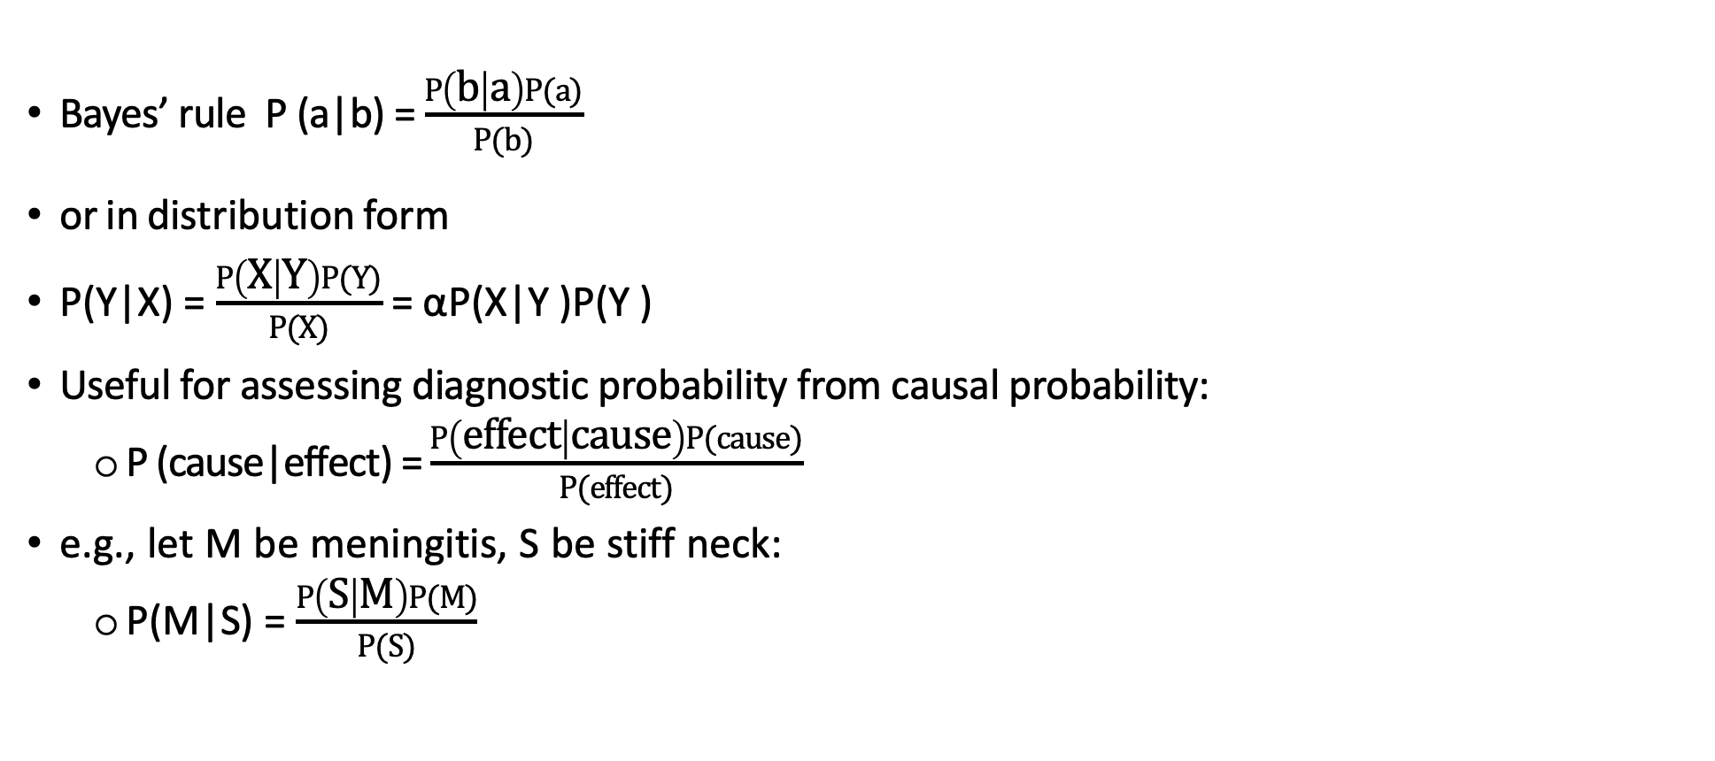
Bayes' Rule
Bayes’ rule P (a|b) = $\frac{P\left(b | a\right)P(a)}{P(b)}$
or in distribution form
P(Y|X) = $\frac{P\left(X | Y\right)P(Y)}{P(X)}$ = αP(X|Y )P(Y )
Useful for assessing diagnostic probability from causal probability:
P (cause|effect) = $\frac{P\left(effect | cause\right)P(cause)}{P(effect)}$
e.g., let M be meningitis, S be stiff neck:
P(M|S) = $\frac{P\left(S | M\right)P(M)}{P(S)}$
Product rule P (a ∧ b) = P (a|b)P (b) = P (b|a)P(a)

Slide 25
Bayes' Rule Conditional Independence
P(cavity|toothache ∧ catch) = α P(toothache ∧ catch| cavity)P( cavity) = α P(toothache|cavity)P(catch|cavity)P(cavity)
This is an example of a naive Bayes model:
P(cause, effect₁, . . ., effect_{n}) = P(cause)Π_{i}P(effect_{i} |cause)
Total number of parameters is linear in n
cavity cause
toothache catch effect₁ effect_{n}

